Slide 1



Standup Comedian Transcript Analysis and Generation
01
An NLP Project By Group 4

Slide 2


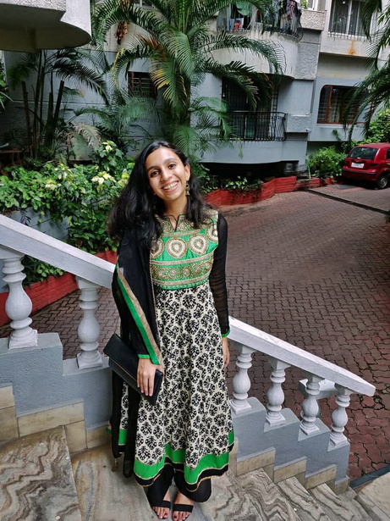
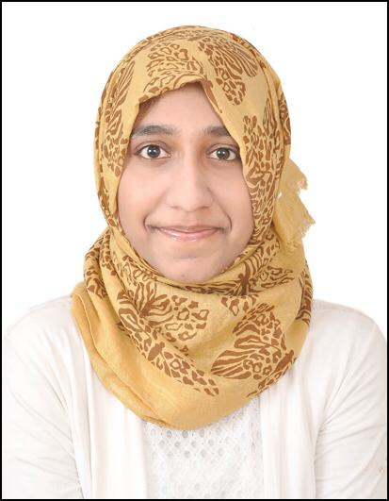

Group Members
Group 4
02
Afzal Mukhtar
Hritika Rahul Mehta
Farheen Zehra
PES2201800675
PES2201800651
PES2201800024

Slide 3




Problem Statement
03
What we want to solve
Approach
Generating a similar text for each standup artist, using Deep Learning Models
Using Deep Learning Models and testing different parameters to get the best generative model.

Slide 4

Overview of Research Methods
The research was done on various aspects of the generative models for Natural Language Processing.
Researching helped us understanding which model will be useful for our use-case.
The papers referred were:
Customizable text generation via conditional text generative adversarial network [Elsevier 2018]: Jinyin Chen, Yangyang Wu, Chengyu Jia, Haibin Zheng, Guohan Huang
Smart Reply: Automated Response Suggestion for Email [ACM 2016]: Anjuli Kannan, Tobias Kaufmann, Karol Kurach, Andrew Tomkins, László Lukács, Vivek Ramavajjala, Sujith Ravi, Balint Miklos, Marina Ganea, Greg Corrado, Peter Young
Diversity regularised auto encoders [ACM 2020]: Hyeseon Ko, Junhyuk Lee, Jinhong Kim, Jongwuk Lee, Hyunjung Shim
Improving Variational Encoder-Decoders in Dialogue Generation (Reference Paper) [AAAI]: Xiaoyu Shen, Hui Su, Shuzi Niu, Vera Demberg
Automatic Generation of Restaurant Reviews with LSTM-RNN [IEE/WIC/ACM 2016]: Alberto Bartoli, Andrea De Lorenzo, Eric Medvet, Dennis Morello, Fabiano Tarlao
04

Slide 5
Data Collection Methods
Scraping and Cleaning
05
Scraping
Cleaning
Data Preperation
The data for the transcripts for each artist was scraped from different websites using web scraping methods and APIs
The Data was cleaned to remove unnecessary words, emojis, emoticons, and expansion of contractions. They were further lemmatized ofr text normalization.
The data was changed into a word to vector representation for word level text generation.

Slide 6
Model Used
An LSTM model was used with input sequence of 100 Words, where a one hot encoded Embedding was used. The softmax function was used as the output layer and a cross-entropy loss function was used for errors.
Project Synopsis
Training Data
The entire transcript of each artist was combined into one and passed to the model for training.
06
Model and Results
Results
Three different models were built. One with stop words, Second without stop words and Third with stop words and drop-out layers.
In all three the one with drop-out generalised better and had an overall lowest perplexity value.

Slide 7

Project Demo
07

Slide 8
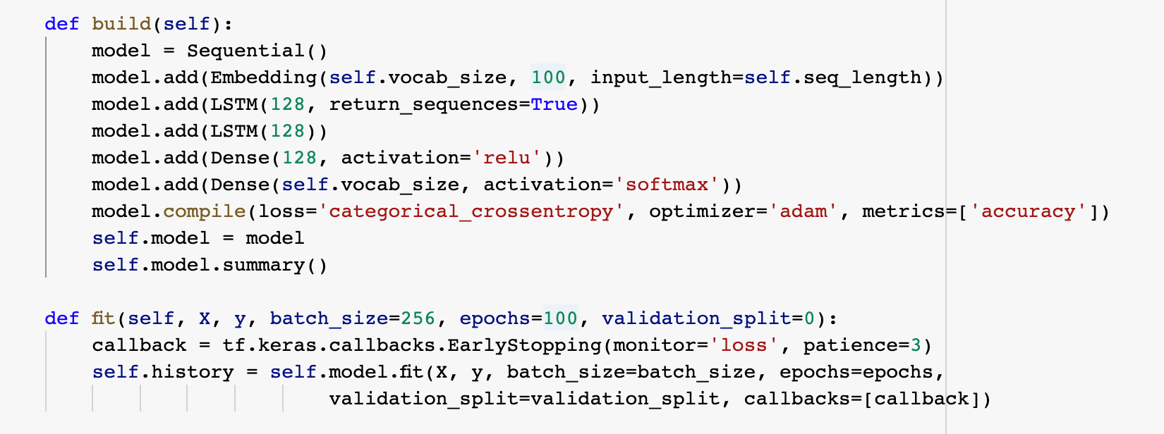
LSTM Model
Model Architecture and Training Parameters
08

Slide 9
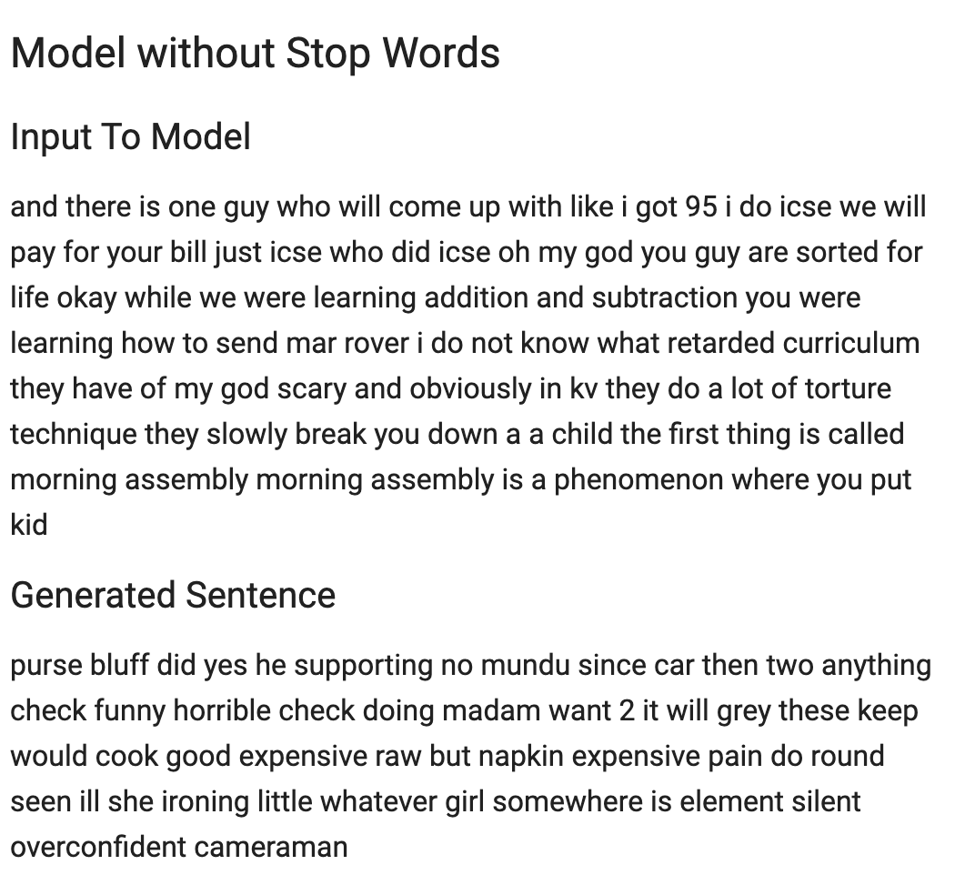
Model Results
09
Model without Stop Words

Slide 10
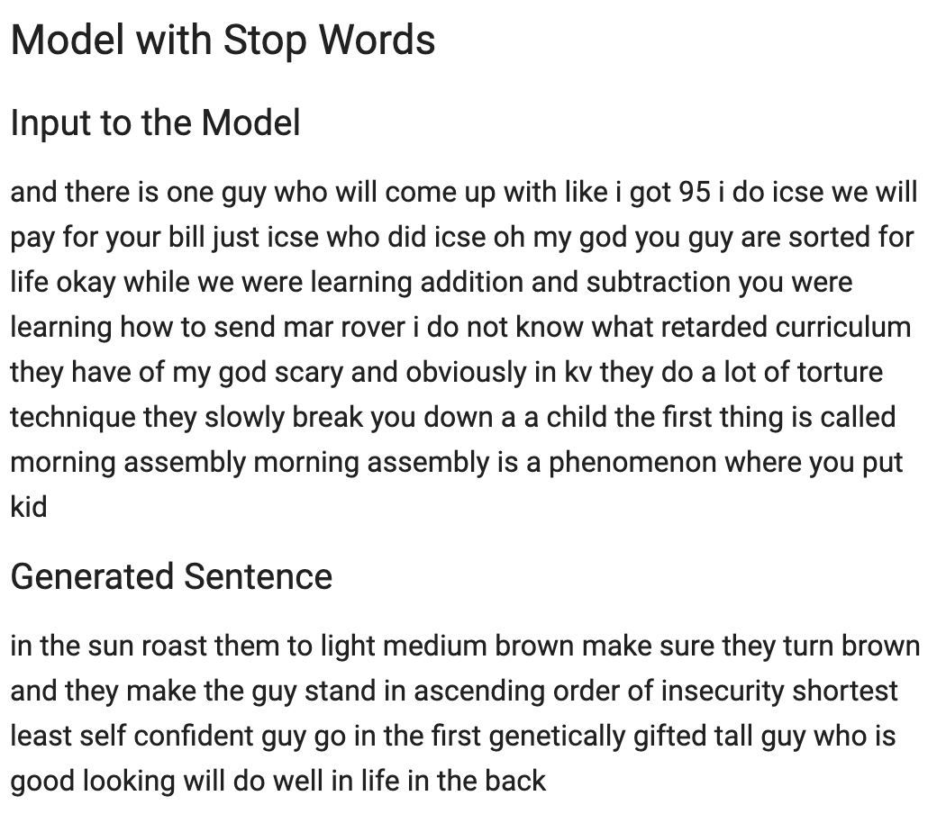
Model Results
10
Model with Stop Words

Slide 11
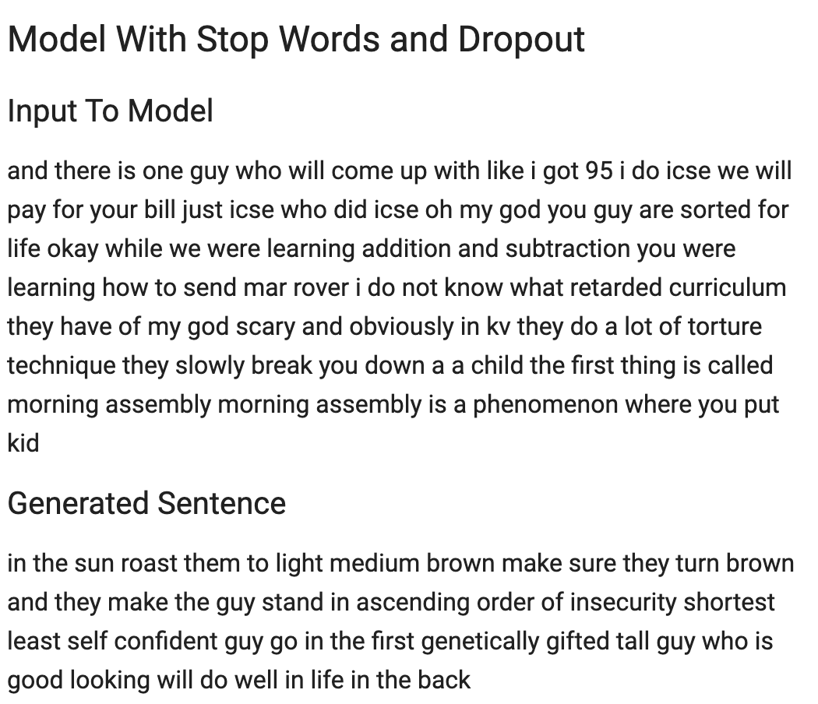
Model Results
11
Model with Stop Words and Dropout

Slide 12
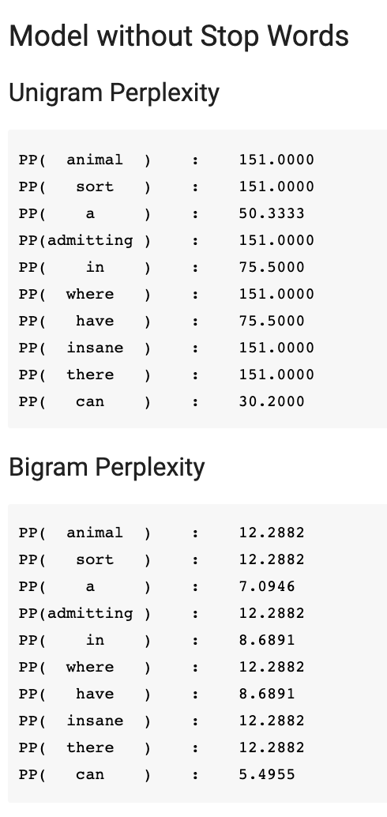
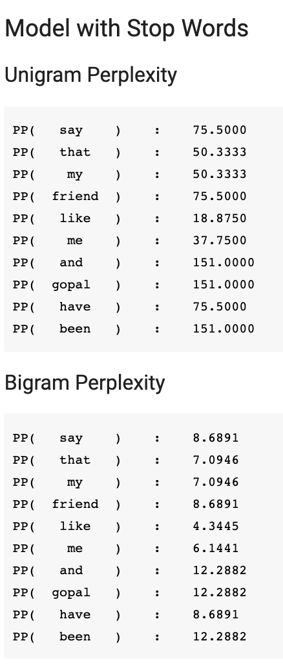
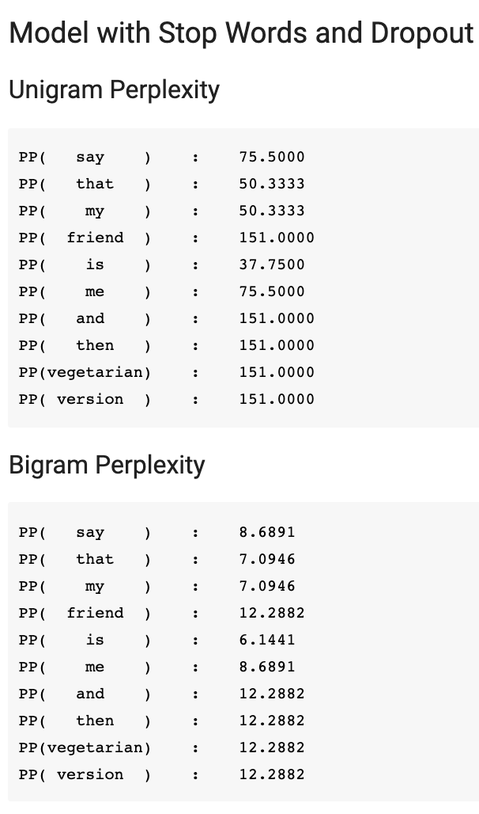
Model Evaluation
12

Slide 13
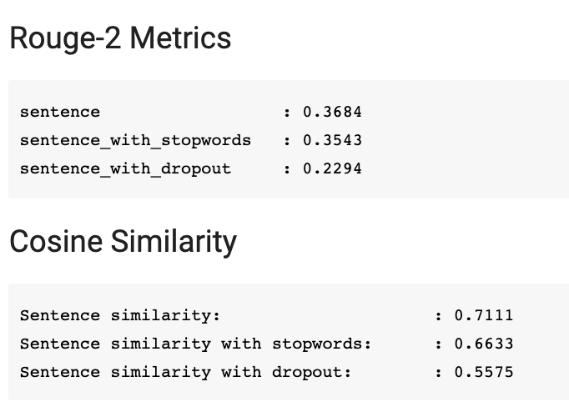
Model Evaluation
13

Slide 14
Trying different Embeddings
Thankyou
Trying different models
14
And Future works
Training on a Larger Dataset

